Slide 1
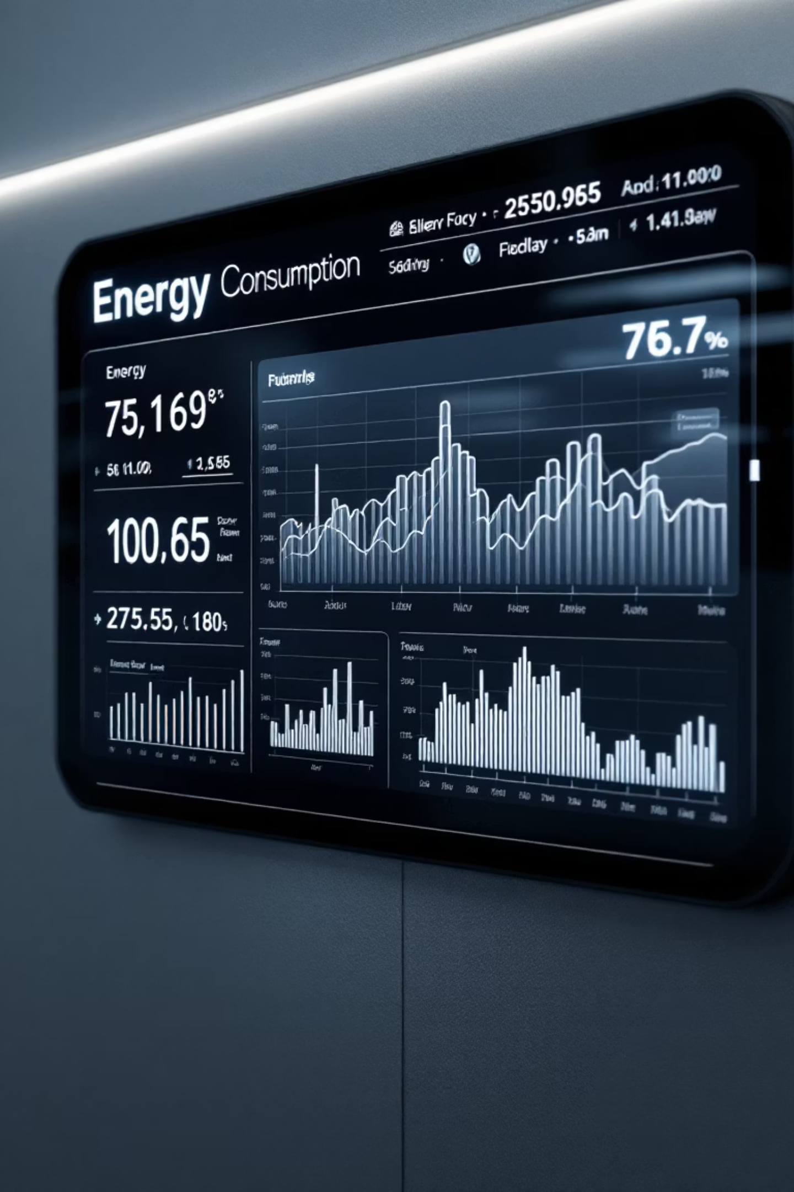
EcoStar Pro: Smart Energy and Resource Consumption Management System
A Project by: Kunal Gangani (FYMCA-A Roll Number 25) and Vijay Amrute (FYMCA-A Roll Number 67)

Slide 2

The Need for Smart Resource Management
Growing Global Concerns
Demand for User-Friendly Tools
Addressing Fragmentation
Rising energy bills and environmental problems show why it's important to manage electricity, gas, and water use wisely.
People need easy-to-use and smart apps that help them easily track and manage their energy and water usage in one place.
Current ways to track energy and water use are manual and spread out, making it hard to get helpful, big-picture insights for saving resources.

Slide 3



Limitations of Existing Systems
Current methods for tracking resource consumption often result in inefficiency and inaction due to several critical flaws:
Manual & Fragmented Tracking
Lack of Real-time Data
Non-Personalized Insights
Users usually get their consumption info weeks or months later, making it hard to change habits quickly or save energy.
Most systems provide general reports but don’t give personal advice based on how each user actually uses energy and resources.
Users depend on paper bills or different sources, making it hard to track energy, water, and gas use all in one place.

Slide 4

EcoStar Pro: System Overview and Core Functionality
EcoStar Pro is a robust, cross-platform application designed to centralize and simplify resource consumption management for households and small businesses.
Cross-Platform Deployment
Real-Time Multi-Resource Tracking
Developed using Python Kivy for a unified experience across Windows, macOS, and Linux desktop environments.
Tracks electricity, gas, and water usage in a single, intuitive interface, providing immediate feedback.
Secure & Personalized Profiles
Features secure authentication and individualized user dashboards to ensure data privacy and relevant insights.

Slide 5




Project Objectives: Defining Success
Our primary goals focus on delivering a high-quality, scalable, and user-centric solution that drives positive change in consumption habits.
Intuitive, Responsive UI
Detailed Tracking & Timelines
Develop an interface compatible with multiple devices, ensuring an optimal user experience regardless of screen size.
Enable users to view consumption history across selectable time frames (daily, weekly, monthly, custom ranges).
Actionable Recommendations
Scalability and Maintainability
Give users personalized tips to save energy and resources based on their own usage data.
Ensure the codebase is modular and structured to facilitate easy updates, feature expansion, and long-term viability.

Slide 6
Scope Definition: Target Users and Modularity
Target Market Applicability
Modular Component Design
EcoStar Pro is specifically designed to address the needs of two primary user groups:
The system architecture prioritizes modularity to ensure flexibility and future-proofing:
Households: Families looking to reduce utility bills and lower their environmental footprint.
Ease of Updates: Independent components simplify bug fixes and maintenance.
Small Businesses: Enterprises seeking cost reduction through efficient resource monitoring and optimization strategies.
Feature Expansion: New modules (e.g., solar integration, device control) can be added without overhauling the core system.
Maintainability: Clear separation of concerns streamlines collaborative development and long-term support.

Slide 7




Technology Stack: Building a Robust Application
We selected a powerful, open-source technology stack to ensure cross-platform compatibility and efficient performance.
Python 3
Kivy GUI Framework
SQLite Database
Core language providing robust, maintainable backend logic for data processing.
Enables rapid development of cross-platform, modern, and responsive user interfaces.
Lightweight, embedded database used for reliable local storage and management of consumption data.
Future Integration Opportunities
The current architecture is set up to easily integrate advanced features like Machine Learning (AI) for complex prediction and cloud synchronization for data backup.

Slide 8
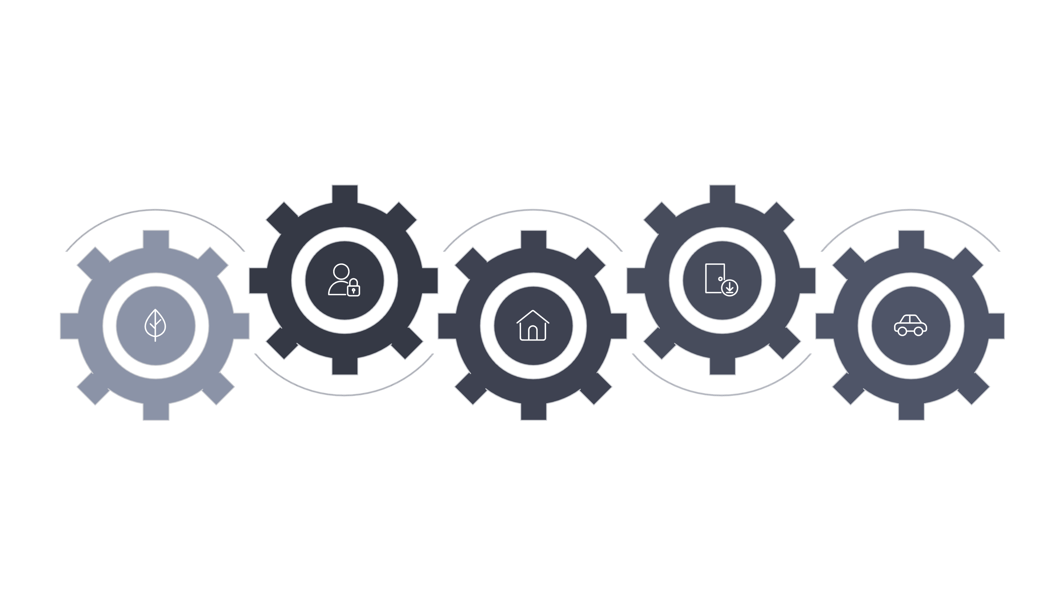





Module Breakdown: Application Structure
User Authentication
Data Input
Secure login and verification process for user access.
Interface for users to enter and submit information.
Splash Screen
Home Dashboard
Application Settings
Initial loading screen for the application's launch sequence.
Main interface displaying key information and navigation.
Configuration options to customize the user experience.

Slide 9
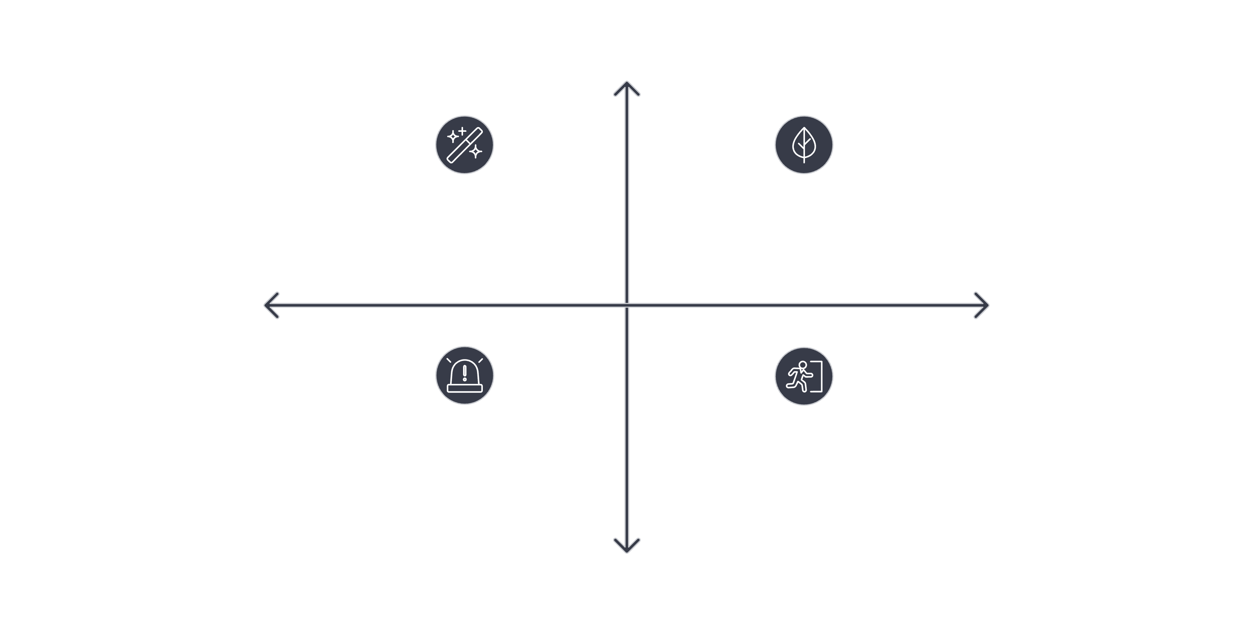




SWOT Analysis: EcoStar Pro Strategic Assessment
High Advantage
Strengths: User-friendly green tech platform
Opportunities: Renewable market expansion
High Vulnerability
High Opportunity
Threats: Regulatory and competitive risks
Weaknesses: Limited enterprise integrations
High Risk

Slide 10
Collaborative Development: Roles and Contributions
A clear division of responsibilities ensured focused development and comprehensive coverage of all critical system components.
Kunal Gangani (Member 1)
Primary development of the Energy Consumption Input Module.
Oversaw the overall UI Design and Theming using Kivy best practices.
Conceptualized and planned the Future Analysis and Tips features.
Vijay Amrute (Member 2)
Developed the core Authentication system (Registration and Login).
Designed and implemented the HomePage and Navigation Drawer architecture.
Managed the Database Integration (SQLite setup and data schema).

Slide 11








Conclusion: Empowering Sustainable Living Through Technology
EcoStar Pro represents a unified effort to deliver a powerful yet accessible tool for resource management, promoting both cost savings and environmental stewardship.
Easy Input
Detailed Analysis
Simple, centralized data logging for multiple resource types.
Visualized data across various time frames (daily, weekly, monthly).
Cross-Platform Reach
Smart Recommendations
Consistent experience across all major desktop operating systems.
Future AI integration for personalized, predictive saving tips.
Thank you. We believe EcoStar Pro is a strong foundation for future sustainable technology solutions.

